Slide 1
Advanced Understanding of Statistical Models for ML
Kevin Ford
kevinf@magenic.com
617 359-5192

Slide 2
https://github.com/Magenic/MMLStatisticalModelsForML
https://www.amazon.com/Machine-Learning-Absolute-Beginners-Introduction-ebook/dp/B07335JNW1?ie=UTF8&redirect=true&ref_=ku_mi_rw_edp

Slide 3
Focus of Class – Model Shapes and Hyper Parameters
What optimizer should I use?
Activation Function?
Kernel (weights)?
How to handle bias?
How many layers?
Layer type?
How many neurons?
How many epochs?
What are the different loss functions?
Batch size?

Slide 4
How do All the Pieces Fit Together?
Run through by number of epochs
Training Data
Layer calculation with neurons
Activation function applied to neurons
Layer calculation with neurons
Activation function applied to neurons
Calculate loss
Optimizer adjusts weights (backpropagation)
Kernel / weights
Validation data
Leaning rate

Slide 5
What is a Gaussian (Normal) Distribution
But what if our data does not use a normal distribution?
Based on X-Y data relationship
Data normally “assumed” to have a normal distribution
New data can be seen to “belong” based on standard deviations

Slide 6
Regressions – normal or not?
Notes:
Q: When we take data and alter it before machine learning like with did with the COVID data, what were we doing and why did it work?
A: We were altering the relationships between the independent and dependent variables to create a relationship with a normal distribution

Slide 7
Is My Data Normal?
import pandas as pd
my_data = pd.Series([1, 2, 3, 4, 5, 6, 7, 8, 9, 10, 8, 6, 4, 2])
my_data.hist()

Slide 8
Core Layers
Input layer – Allows a septate layer just to define the input shape
Use instead of the input_shape parameter on the first layer
Has no calculation impact on the model
Easier to comment out and play with other layers without moving the input_shape parameter around
Should be the first layer in a model
model.add(keras.layers.Input(shape=(RESHAPED,)))
Activation layer – Simply applies an activation function to the results of the last layer
model.add(keras.layers.Activation('relu'))

Slide 9
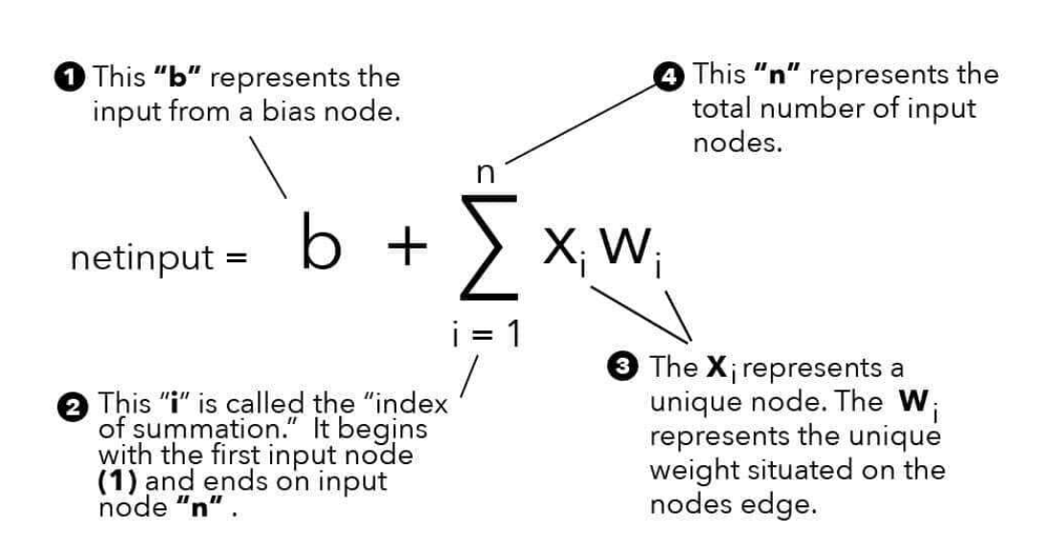
Core Layers
Dense layer – has a number of neurons that are each mapped to the neurons in the prior and following layers
model.add(keras.layers.Dense(N_HIDDEN, name='hidden_dense_layer', activation='relu'))

Slide 10
Ragged vs Sparse Tensors
Ragged Tensors are dense tensors with an irregular shape
A common usage is with natural language understanding where phrases come in different lengths
Conceptually similar to nested variable length lists
speech = tf.ragged.constant( [['All', 'the', 'world', 'is', 'a', 'stage'], ['And', 'all', 'the', 'men', 'and', 'women', 'merely', 'players'], ['They', 'have', 'their', 'exits', 'and', 'their', 'entrances']])
A sparse tensor is a tensor where some values should be ignored (are “blank”)
A sparse tensor is a tensor with three dense tensors: indices, values, and dense_shape
SparseTensor(indices=[[0, 0], [1, 2]], values=[1, 2], dense_shape=[3, 4])
[[1, 0, 0, 0] [0, 0, 2, 0] [0, 0, 0, 0]]
=
Generally a layer can specify the input is ragged or sparse but not both

Slide 11
Core Layers
Embedding layer – Compresses the input feature space into a smaller one
Normally used with language recognition or where there are sparse tensors
Used as first layer
Hope to see you soon
Nice meeting you
[1, 2, 3, 4, 5]
[6, 7, 4, 0, 0] #fill with zeros due to padding
=>
Model.add(keras.layers.Embedding(8, 2, input_length=5)
| 0 | [1.2, 3.1, 2.5] |
| 1 | [0.1, 4.2, 1.5] |
| 2 | [1.0, 3.1, 2.2] |
| 3 | [0.3, 2.1, 2.0] |
| 4 | [2.2, 1.4, 1.2] |
| 5 | [0.7, 1.7, 0.5] |
| 6 | [4.1, 2.0, 4.5] |
| 7 | [3.1, 1.0, 4.0] |
Hope to see you soon becomes
[[4.1, 2.0, 4.5], [3.1, 1.0, 4.0], [2.2, 1.4, 1.2], [1.2, 3.1, 2.5], [1.2, 3.1, 2.5]]

Slide 12
Demo 1: Embedding Layer

Slide 13
Core Layers
Masking layer – uses a mask value to skip timesteps with a specified value
Used with time series models with missing data (sparse)
Removes timestep for down steam calculations in subsequent layers
Meant to remove the skew of missing readings
Reading
Time

Slide 14
Demo 2: Masking Layer

Slide 15
Core Layers
Lamda layer – Executes an arbitrary function against every value from the prior layer
Variables used in Lamda functions are not thread safe, functions should be stateless
Primarily used for prototyping
It is preferable to create a custom layer instead of using Lamda functions in production models
model.add(tf.keras.layers.Lambda(lambda x: (math.pi * x) ** 2, input_shape=(values, features)))

Slide 16
Demo 3: Lamda Layer

Slide 17
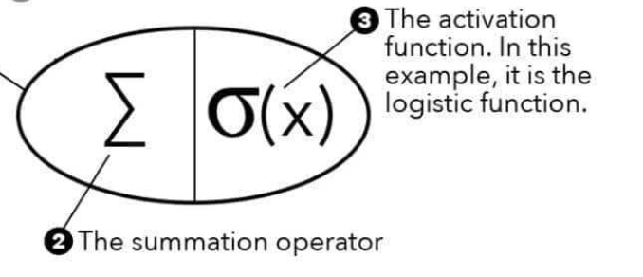
Activation Functions
An activation functions transforms the data to help it learn complex patterns by adding non-linearity to the model

Slide 18
What should an activation function be concerned with?
“vanishing gradient” problem – happens with weights between 0-1 with many layers on backpropagation
When back propagating a weight adjustment, what is the result if the following weight changes are determined in each layer?
0.25 * 0.1 * 0.25 * 0.50 = .003125
Zero Centered – does not shift the values to the left or the right
Computational Inexpense – activation functions may run millions of times during training
Differentiable – layers need to have differentiated output – a layer that converts all values to 1 is going to stop the learning process

Slide 19
Linear
Vanishing gradient?
Computationally Inexpensive?
Zero Centered?
Differentiable?
Other observations?
Notes:
Vanishing gradient – yes
Computationally inexpensive – yes
Zero centered – yes
Differentiable – yes
it is the equivalent of not altering the layers values at all. Leads to not helping with non-linear problems
Can lead to very large numbers being calculated together and eventual overflow issues

Slide 20
Sigmoid
Vanishing gradient?
Computationally Inexpensive?
Zero Centered?
Differentiable?
Other observations?
Notes:
Vanishing gradient – yes
Computationally inexpensive – no
Zero centered – no
Differentiable – yes
Expensive to use, it has fallen to the wayside

Slide 21
Softmax
Vanishing gradient?
Computationally Inexpensive?
Zero Centered?
Differentiable?
Other observations?
Notes:
Vanishing gradient – no
Computationally inexpensive – no
Zero centered – no
Differentiable – yes
Purpose is to calculate the probability of individual outputs in relation to each other to sum up to 1. Used in last layer.

Slide 22
Tanh
Vanishing gradient?
Computationally Inexpensive?
Zero Centered?
Differentiable?
Other observations?
Notes:
Vanishing gradient – yes
Computationally inexpensive – no
Zero centered – yes
Differentiable – yes
Expensive to use, it has fallen to the wayside, similar to Sigmoid but zero centered

Slide 23
ReLu – Rectified Linear Unit
Vanishing gradient?
Computationally Inexpensive?
Zero Centered?
Differentiable?
Other observations?
Notes:
Vanishing gradient – no
Computationally inexpensive – yes
Zero centered – no
Differentiable – yes * see dying relu issue
Like linear, can lead to very large numbers being calculated together and eventual overflow issues
Causes nodes that are zero to no longer contribute. This is referred to as “dying relu”

Slide 24
Leaky ReLU / Parametric ReLU
Vanishing gradient?
Computationally Inexpensive?
Zero Centered?
Differentiable?
Other observations?
Notes:
Vanishing gradient – no
Computationally inexpensive – yes
Zero centered – no - but more so than ReLU
Differentiable – yes
Similar to RELU, designed to solve the dying Relu issue

Slide 25
ReLU6
Vanishing gradient?
Computationally Inexpensive?
Zero Centered?
Differentiable?
Other observations?
Notes:
Vanishing gradient – no
Computationally inexpensive – yes
Zero centered – no - but more so than ReLU
Differentiable – yes * see dying relu issue
Similar to ReLU, designed to solve the issue of overflows in the training process due to large numbers
Like ReLU, has the dying RELu issue

Slide 26
Swish
Vanishing gradient?
Computationally Inexpensive?
Zero Centered?
Differentiable?
Other observations?
Notes:
Vanishing gradient – no
Computationally inexpensive – no
Zero centered – no
Differentiable – yes
Easier to finish gradient descent than ReLU due to no hard 0 point of cutoff, expensive

Slide 27
Hard-Swish or H-Swish
Vanishing gradient?
Computationally Inexpensive?
Zero Centered?
Differentiable?
Other observations?
Notes:
Vanishing gradient – no
Computationally inexpensive – yes
Zero centered – no
Differentiable – yes
Easier to finish gradient descent than ReLU due to no hard 0 point of cutoff
Seems not to be in TensorFlow, would need to create a custom activation

Slide 28
When to use activation functions:
Linear – Generally won’t as it doesn’t change the values
Sigmoid – Generally won’t, causes vanishing gradient and computationally expensive
Softmax – Normally used on the output layer of a classification problem
Tanh – Generally won’t, causes vanishing gradient and computationally expensive
ReLU – Should be your normal starting point for an activation function
Leaky ReLU – Use if ReLU stops learning and you suspect a dying ReLu problem
Relu 6– Use if causes overflow issues with very large numbers
Swish – Stay away due to computational expense excp in smaller models where ReLu may have stopped learning

Slide 29
Demo 4: Exploring Activation Functions

Slide 30
Homework reading
https://towardsdatascience.com/what-if-your-data-is-not-normal-d7293f7b8f0
https://towardsdatascience.com/6-ways-to-test-for-a-normal-distribution-which-one-to-use-9dcf47d8fa93
https://gdcoder.com/what-is-an-embedding-layer/
https://towardsdatascience.com/everything-you-need-to-know-about-activation-functions-in-deep-learning-models-84ba9f82c253
Book Chapters 1 - 7
Homework, following slides: answer the “five” questions for each activation function

Slide 31
Homework activation functions
softplus(x) = log(exp(x) + 1)
softsign(x) = x / (abs(x) + 1)

Slide 32
Q & A
New week – loss functions

